Slide 1
Introducing Arduino & Dino:
Ruby meets the physical world!
David Grayson
Las Vegas Ruby Group, 2013-1-30

Slide 2
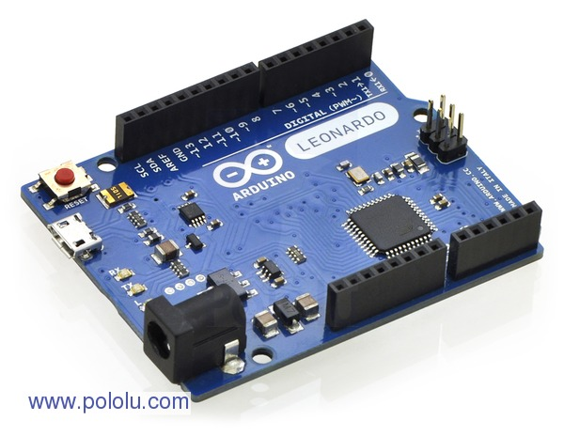
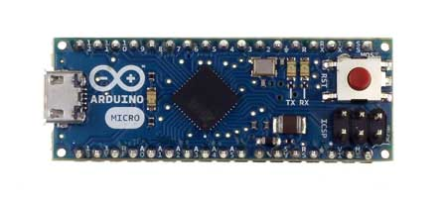

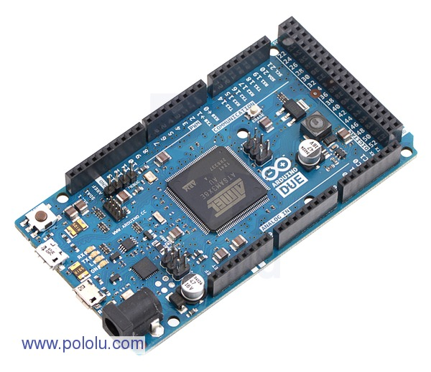
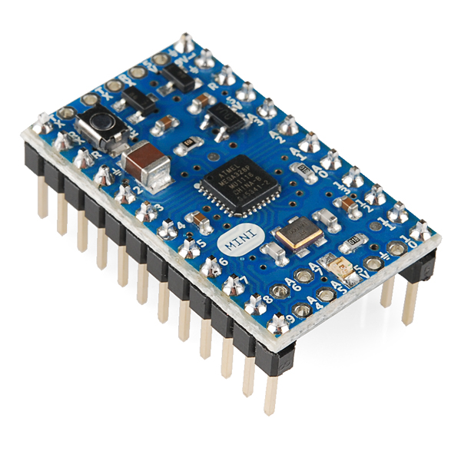
Arduino
Pictures taken from pololu.com, arduino.cc, sparkfun.com

Slide 3
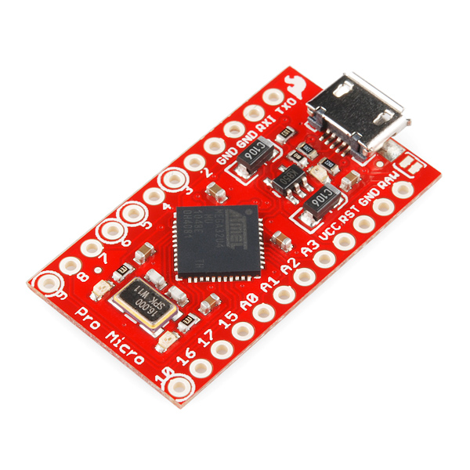
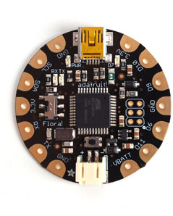
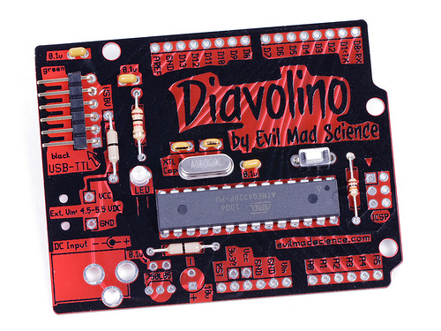
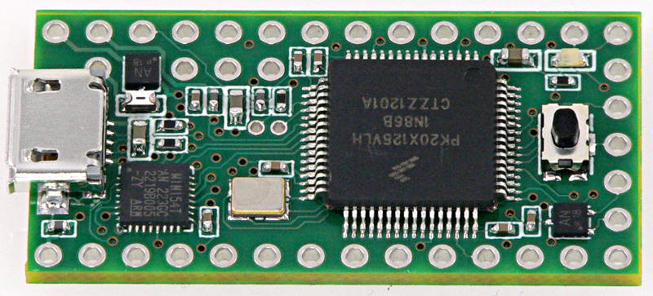

Pictures taken from sparkfun.com, adafruit.com, pjrc.com, evilmadscientist.com, kickstarter.com (digispark)

Slide 4
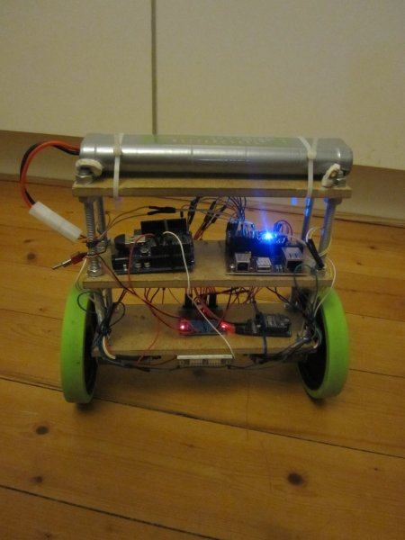
http://blog.tkjelectronics.dk/2012/03/the-balancing-robot/

Slide 5
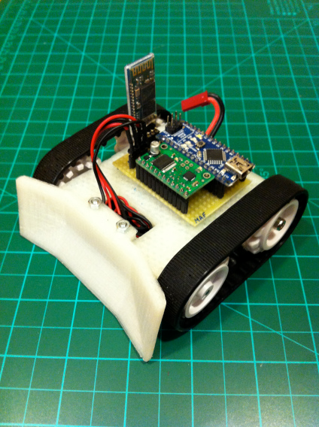
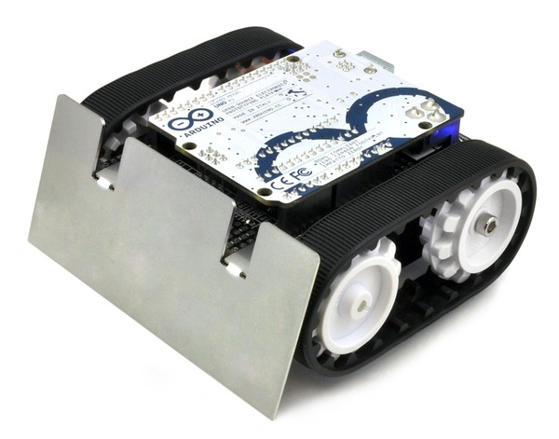
http://madebyfrutos.wordpress.com/2013/01/12/bobobot/
Pololu Zumo Robot

Slide 6
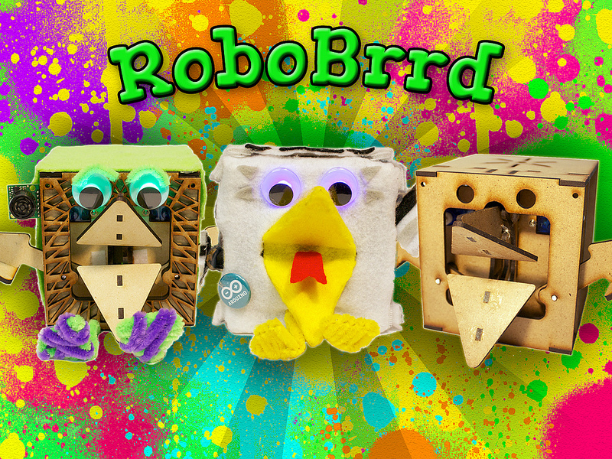
http://www.indiegogo.com/robobrrd

Slide 7
So many projects...
http://www.instructables.com/id/Arduino-Projects/
http://www.pololu.com/resources/communityprojects

Slide 8
Arduino = AVR + USB + IDE

Slide 9

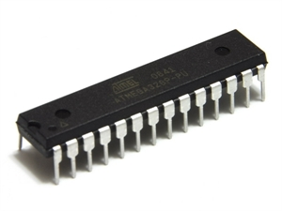
Your PC vs. ATmega328P

Slide 10
$1950.00
$3.16
or less

Slide 11
1,006 GB
32 KB

Slide 12
16 GB
2 KB

Slide 13
2.4 GHz
20 MHz

Slide 14
30 seconds
0.003
seconds

Slide 15
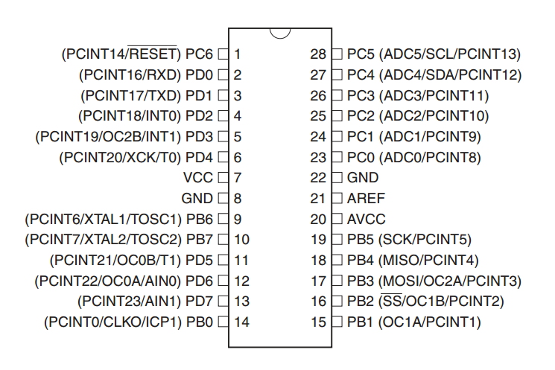
Screen, keyboard, touchpad, USB, ethernet, HDMI, VGA, SD card, DVD drive, WiFi, Bluetooth

Slide 16
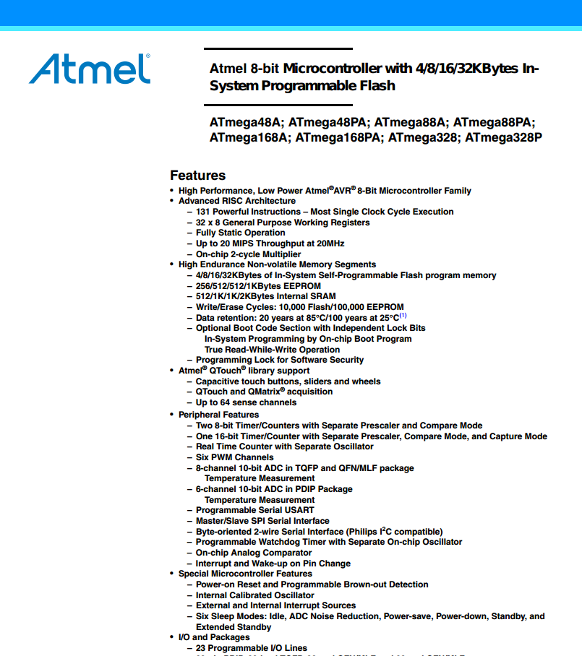

Documentation

Slide 17
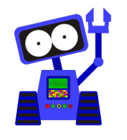


LVBots

Slide 18
BIOS,
OS,
Processes,
Threads,
Registers,
Interrupts
(maybe bootloader)

Slide 19

C/C++
avr-gcc

Slide 20
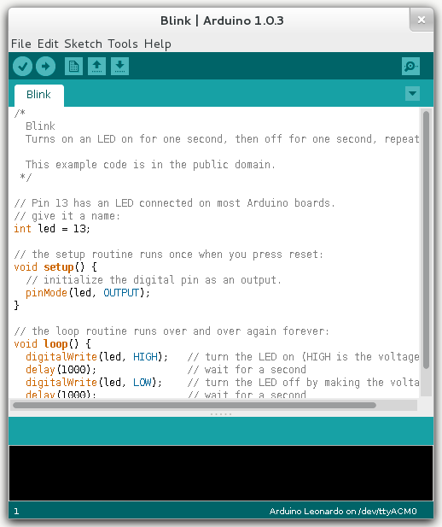

Slide 21
Dino
Control your Arduino from Ruby!

Slide 22
Dino
Author: Austin Vance
Source: http://github.com/austinbv/dino
RubyConf 2012 Talk

Slide 23
Blink LED
require 'dino'
board = Dino::Board.new(Dino::TxRx.new)
led = Dino::Components::Led.new(pin: 13, board: board)
[:on, :off].cycle do |switch|
led.send(switch)
sleep 0.5
end

Slide 24
…could be cleaner:
require 'dino'
board = Dino::Board.new
led = board.new_led(13)
[:on, :off].cycle do |switch|
led.send(switch)
sleep 0.5
end

Slide 25
Sensor
require 'dino'
board = Dino::Board.new(Dino::TxRx.new)
sensor = Dino::Components::Sensor.new(pin: 'A0',
board: board)
on_data = Proc.new do |data|
p data
end
sensor.when_data_received(on_data)
sleep

Slide 26
…could be WAY cleaner:
require 'dino'
board = Dino::Board.new
sensor = board.analog_inputs[0]
puts sensor.voltage # => 4.0185546875

Slide 27
Other components...

Slide 28
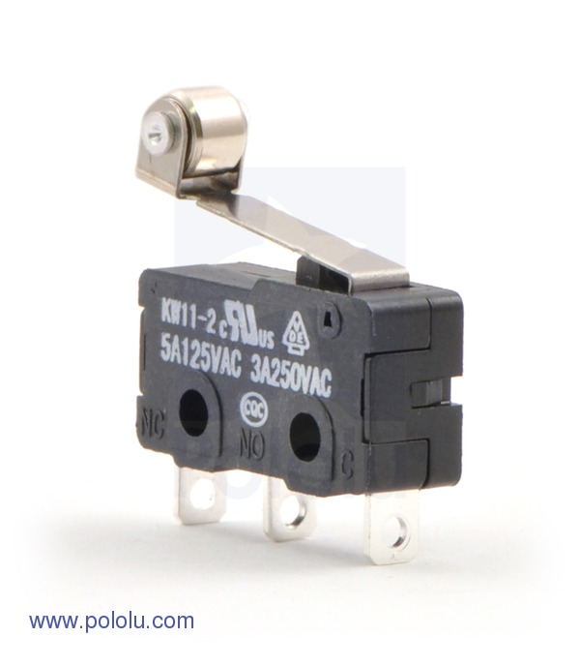
Button

Slide 29
IR Receiver

Slide 30
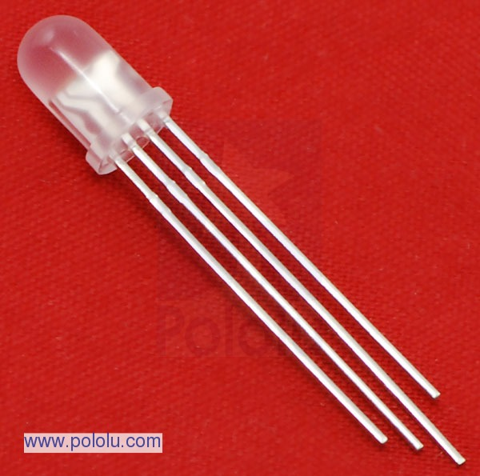
RGB Led

Slide 31
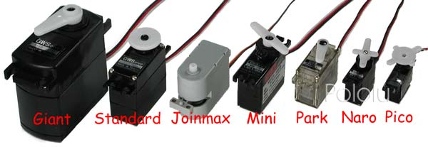
Servo

Slide 32
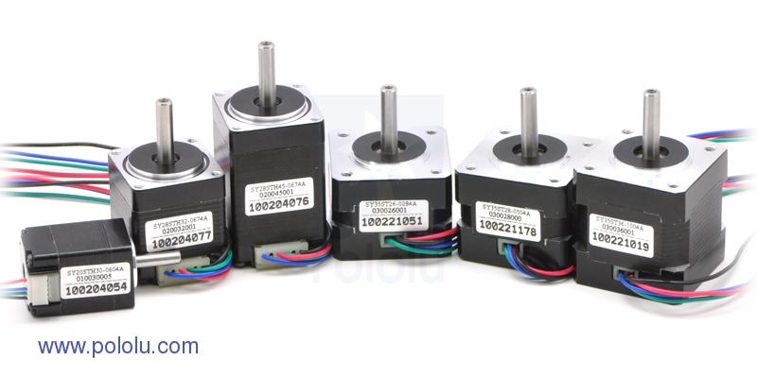
Stepper

Slide 33
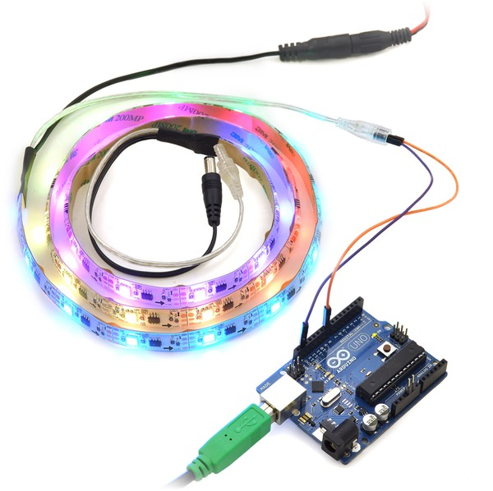
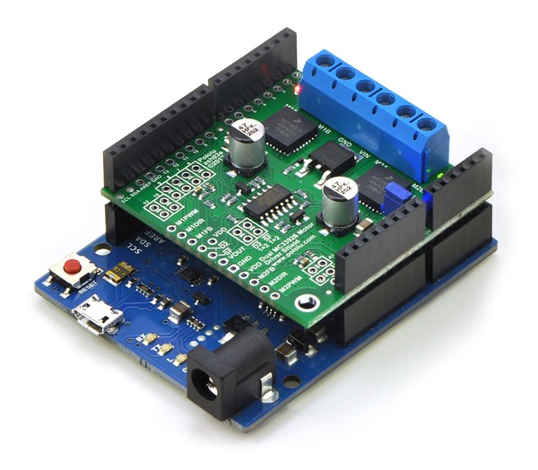
Shields & Libraries

Slide 34
More info about Dino:
http://playground.arduino.cc/interfacing/ruby
https://github.com/austinbv/dino
http://confreaks.com/videos/1294-rubyconf2012-arduino-the-ruby-way

Slide 35


